Slide 1
Customizable Postcards
For Seekers

Slide 2

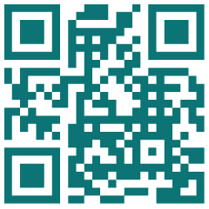

EXAMPLE
Find help near you!
Go to neighborly.findhelp.com to search for food, housing, healthcare, support, transportation, education, legal support and more, locally.
It's free and easy to use.
View hours and locations.
Find free and reduced-cost services
Apply for benefits
Is Neighborly helpful?
Share this with a friend!

Slide 3




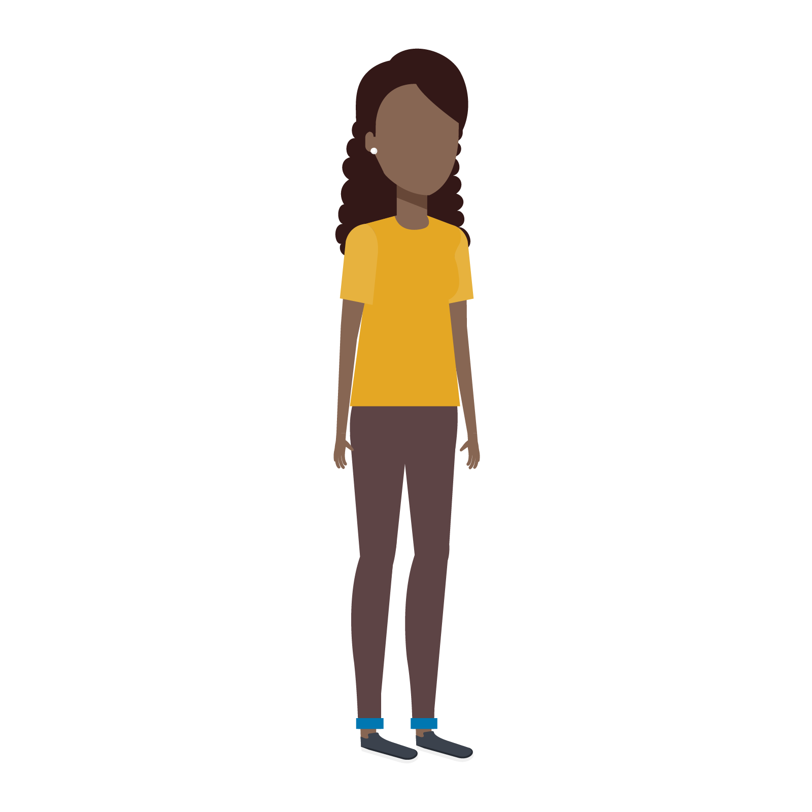



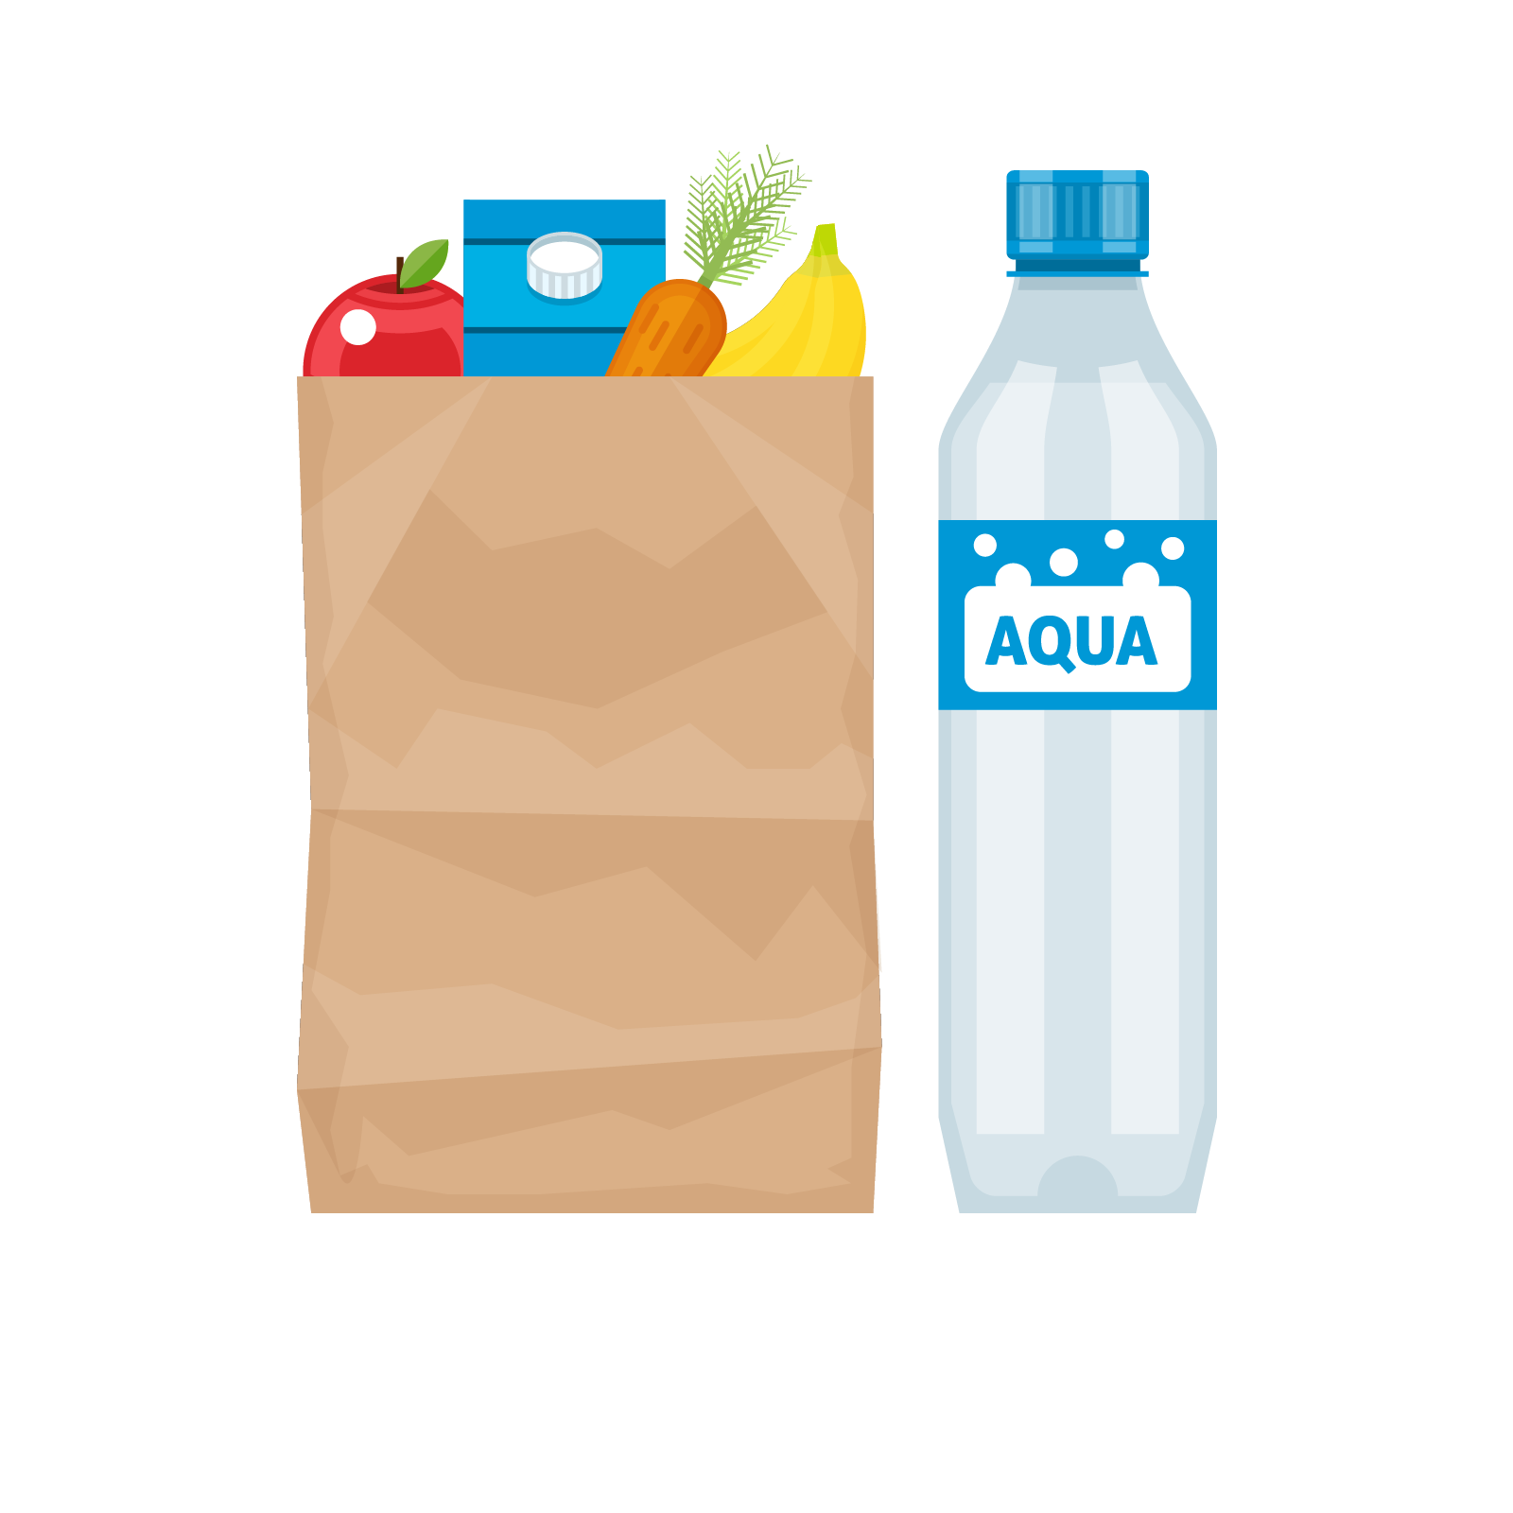
EXAMPLE
Connect to Resources
1
2
3
Mary is a single parent who was discharged from the hospital. She lives in an unsafe home with leaky pipes.
Sarah, a Navigator, asks Mary some questions about her current situation.
After answering the questions, Sarah identifies resources on Neighborly that could help Mary and her family.
4
5
Search & connect for free!
In addition to the resources Sarah provides Mary, Sarah also encourages her to use Neighborly to self-connect to more programs.
Mary thanks Sarah for helping her; she is already on the phone looking up more resources.

Slide 4
English Version

Slide 5
Find help near you!
CUSTOMER ICON
Go to [CUSTOMER SITE URL] to search for food, housing, healthcare, support, transportation, education, legal support and more, locally.
CUSTOMER SITE QR CODE
Please create your own QR code and insert here
It's free and easy to use.
View hours and locations.
Find free and reduced-cost services
Apply for benefits
CUSTOMER LOGO
Is [CUSTOMER SITE] helpful?
Share this with a friend!

Slide 6
Connect to Resources
1
2
3
Mary is a single parent who was discharged from the hospital. She lives in an unsafe home with leaky pipes.
After answering the questions, Sarah identifies resources on [CUSTOMER SITE] that could help Mary and her family.
Sarah, a Navigator, asks Mary some questions about her current situation.
4
5
Search & connect for free!
CUSTOMER LOGO
In addition to the resources Sarah provides Mary, Sarah also encourages her to use [CUSTOMER SITE] to self-connect to additional programs.
Mary thanks Sarah for helping her; she is already on the phone looking up more resources.

Slide 7
Spanish Version

Slide 8
¡Encuentra ayuda cerca de ti!
CUSTOMER ICON
Vaya a [CUSTOMER SITE URL] para buscar alimentos, vivienda, atención médica, apoyo, transporte, educación, apoyo legal y más, a nivel local.
CUSTOMER SITE QR CODE
Please create your own QR code and insert here
Es gratis y fácil de usar.
Ver horarios y ubicaciones
Encuentre servicios gratuitos y de costo reducido
Solicitar beneficios
CUSTOMER LOGO
¿Es útil [CUSTOMER SITE]?
¡Comparte esto con un amigo!

Slide 9
Conectarse a Recursos
1
2
3
María es madre soltera que acaba de salir del hospital. Vive en una casa inestable con fugas en las tuberías.
Al escuchar las respuestas, Sara identifica recursos en [CUSTOMER SITE] que podrían ayudar a Maria y su familia.
La promotora de salud, Sara, hace una serie de preguntas sobre la situación actual de María.
4
5
Busca y conecta sin costo
CUSTOMER LOGO
Además de compartir los recursos con María, Sara le anima a visitar [CUSTOMER SITE] para buscar programas adicionales.
María le agradece a Sara y empieza a buscar otros recursos desde su teléfono celular.

Slide 10
English-Spanish

Slide 11
Find help near you!
CUSTOMER ICON
Go to [CUSTOMER SITE URL] to search for food, housing, healthcare, support, transportation, education, legal support and more, locally.
CUSTOMER SITE QR CODE
Please create your own QR code and insert here
It's free and easy to use.
View hours and locations.
Find free and reduced-cost services
Apply for benefits
CUSTOMER LOGO
Is [CUSTOMER SITE] helpful?
Share this with a friend!

Slide 12
¡Encuentra ayuda cerca de ti!
CUSTOMER ICON
Vaya a [CUSTOMER SITE URL] para buscar alimentos, vivienda, atención médica, apoyo, transporte, educación, apoyo legal y más, a nivel local.
CUSTOMER SITE QR CODE
Please create your own QR code and insert here
Es gratis y fácil de usar.
Ver horarios y ubicaciones
Encuentre servicios gratuitos y de costo reducido
Solicitar beneficios
CUSTOMER LOGO
¿Es útil [CUSTOMER SITE]?
¡Comparte esto con un amigo!

